Slide 1
APEXPLANET INTERNSHIP
TASK 4
Sales Performance Analysis
Business Intelligence & Statistical Validation
ApexPlanet Software Pvt. Ltd. — Data Analytics Internship
Prepared by: Pavvana Sai Shree P E

Slide 2
Project Context
Executive Summary
Project Objective
Analyse sales performance, identify revenue drivers, validate business assumptions using statistical analysis, and provide actionable recommendations to support strategic decision-making.
Dataset Overview
1,000 sales transactions
947 unique customers
12 business attributes
Missing values: Age (20), City (13)
Tools: Python, Pandas, Matplotlib, SciPy

Slide 3
Performance Metrics
KPI Dashboard
A snapshot of the five most critical sales performance indicators derived from the dataset.
₹139.4M
992
947
Total Revenue
Total Orders
Unique Customers
₹139K
5,435
Avg Order Value
Quantity Sold

Slide 4
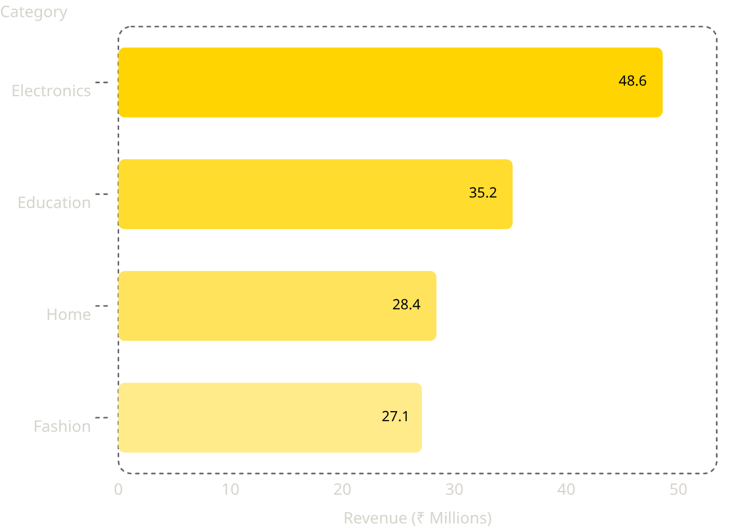

Revenue Breakdown
Category Performance Analysis
Key Findings
Electronics contributed the largest share of total revenue, indicating strong demand and high market potential.
Education emerged as the second-best performing category with consistent purchasing behaviour.
Fashion generated the lowest revenue, suggesting opportunities for targeted promotional campaigns.
Recommendation: Increase investment in Electronics while introducing promotional strategies to uplift Fashion sales.

Slide 5
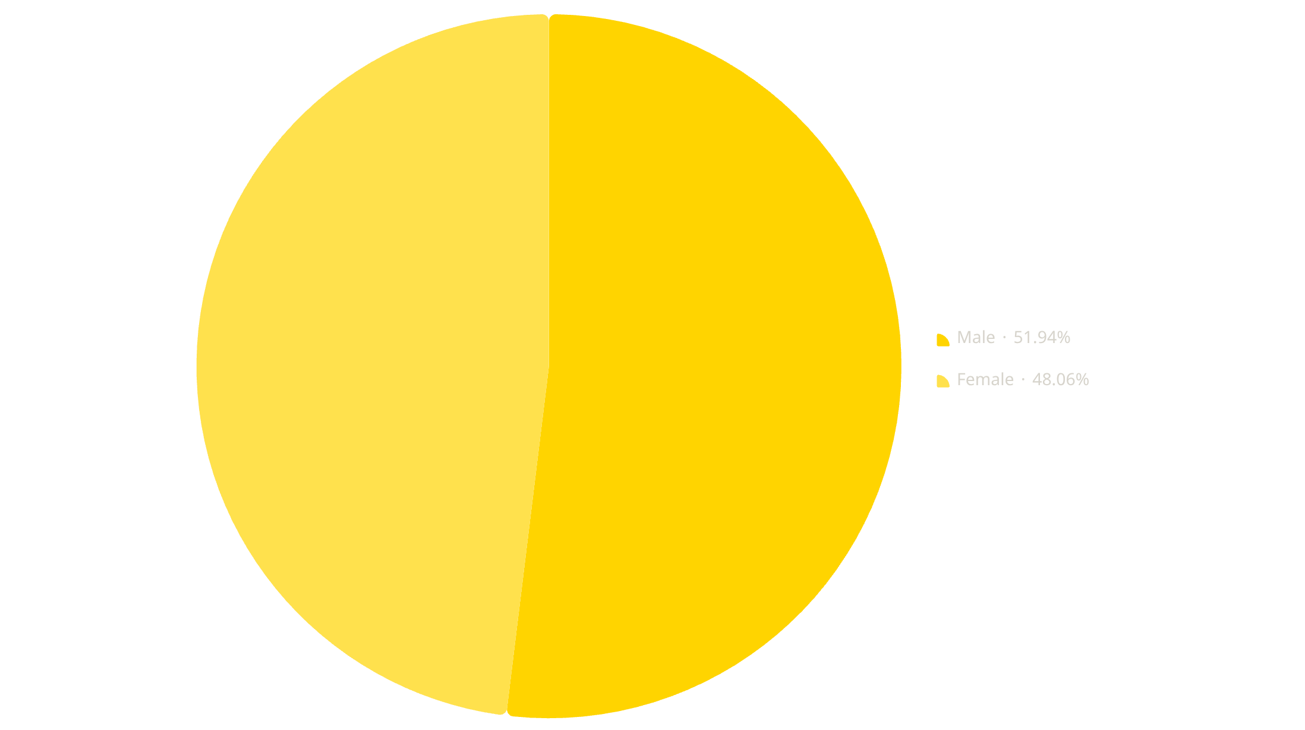


Customer Demographics
Sales by Gender
Observations
52%
48%
Male Customers
Female Customers
Statistical Validation
The Independent Sample T-Test produced p = 0.4954. Since p > 0.05, there is no statistically significant difference in average spending between male and female customers.

Slide 6
Product & Geographic Insights
Where Revenue Comes From
Product Insights
Geographic Insights
Laptop generated the highest revenue across all products.
Mobile ranked second, reinforcing technology dominance.
Electronics and tech accessories drive the majority of sales volume.
Patna generated the highest revenue among all cities.
Kolkata, Bengaluru and Mumbai demonstrated consistently strong performance.
Lower-performing cities present untapped opportunities for market expansion.

Slide 7
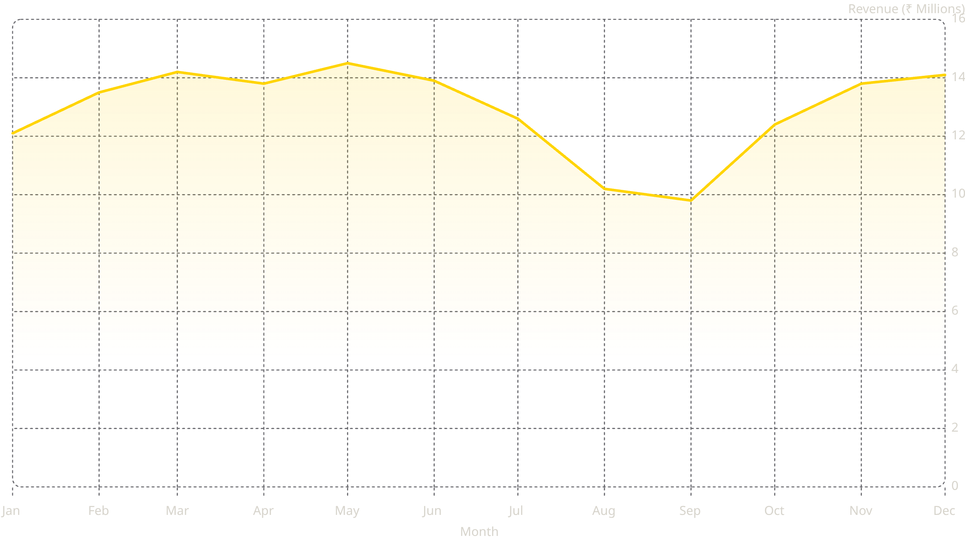
Monthly Performance
Sales Trend Analysis
Trend Analysis
Business Interpretation
Revenue increased steadily during the first half of the year.
August and September experienced a noticeable decline.
Strong recovery was observed during Q4.
Seasonal demand fluctuations should be investigated to optimise inventory planning and marketing expenditure during low-performance periods.

Slide 8
Hypothesis Testing
Statistical Validation
Hypothesis
Result
Null Hypothesis (H₀)
Male and Female spending is equal
Alternative (H₁)
Male and Female spending differs
Test Used
Independent Sample T-Test
T Statistic
0.6820
P Value
0.4954
Decision
Fail to Reject H₀
Interpretation: Customer spending behaviour is independent of gender. Marketing campaigns may continue targeting both demographics equally.

Slide 9
Actionable Insights
Strategic Recommendations

Slide 10

Key Takeaways
Conclusion
KPIs Calculated
Five core metrics established a comprehensive revenue baseline.
Charts Created
Category, gender, product, geographic and trend visualisations delivered.
Hypothesis Validated
T-Test confirmed no significant gender-based spending difference.
Recommendations Delivered
Five strategic actions proposed to optimise revenue and growth.

